Slide 1
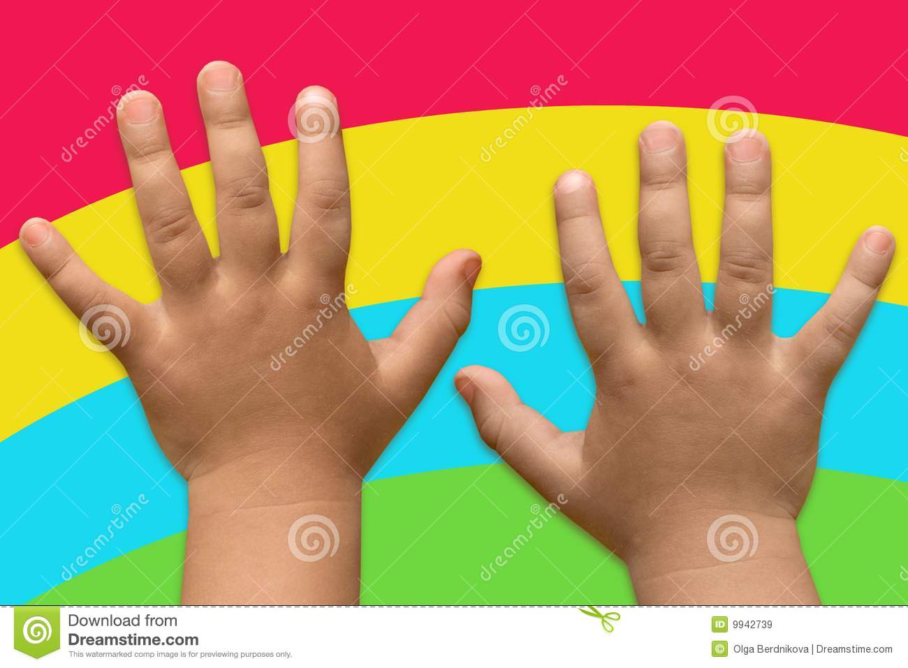
We have
kind hands.

Slide 2
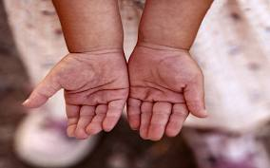
How many hands
do you have?

Slide 3
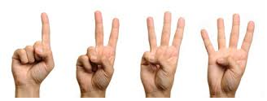
How many fingers do you
have on each hand?

Slide 4

How many thumbs do you
have on each hand?

Slide 5
What can you do
with your hands?

Slide 6
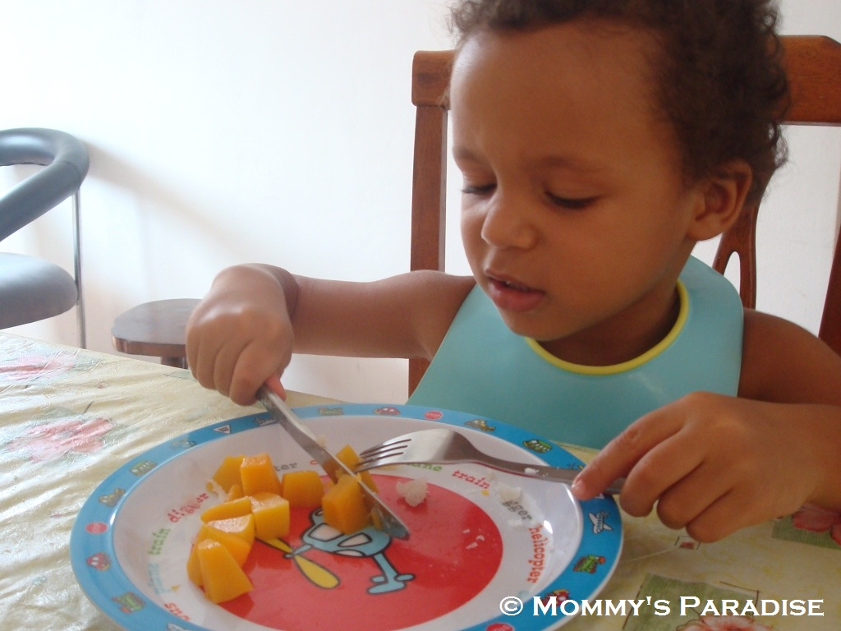
You can use your hands
to eat your lunch.

Slide 7
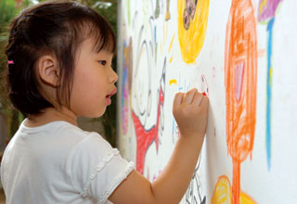
You can use your hands to draw
a picture or write your name.

Slide 8
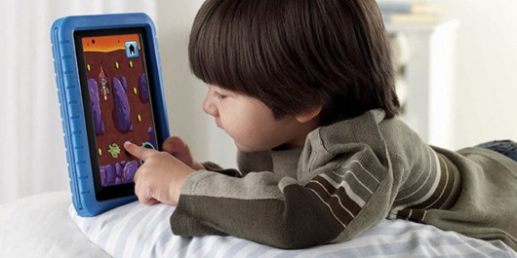
You can use your hands to
play computer games.

Slide 9
There are times when our
hands can do naughty things
that are not nice.

Slide 10
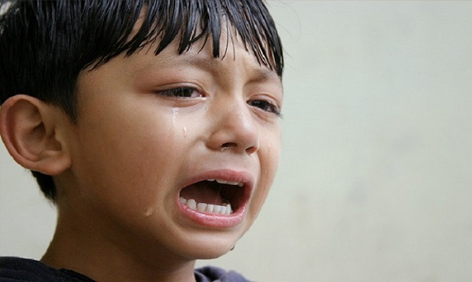
These things can make people sad.
Have you ever made your friend
sad with your hands?

Slide 11
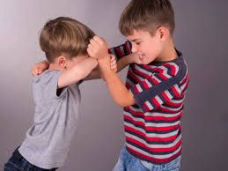
Hitting or punching.

Slide 12

Snatching toys.

Slide 13
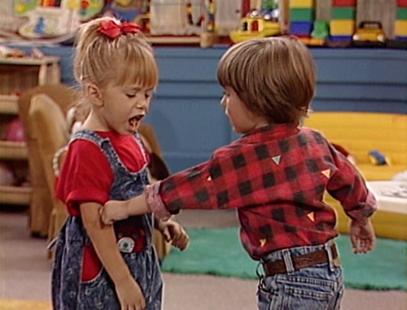
Pinching.

Slide 14

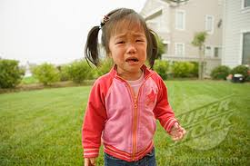

When your hands do naughty things like
this it can make your friends sad.

Slide 15
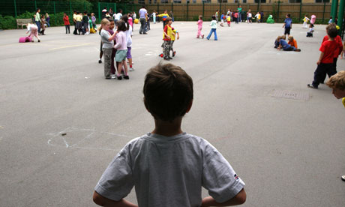
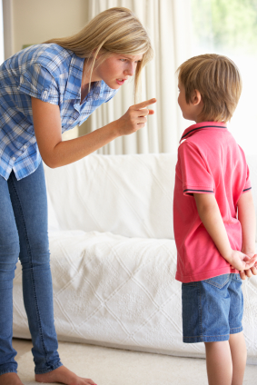
Then you can
get told off.
And your friends
won’t want to
play with you.

Slide 16
So remember to use your hands
for good things.

Slide 17
What else do you
use your hands for?

